Slide 1
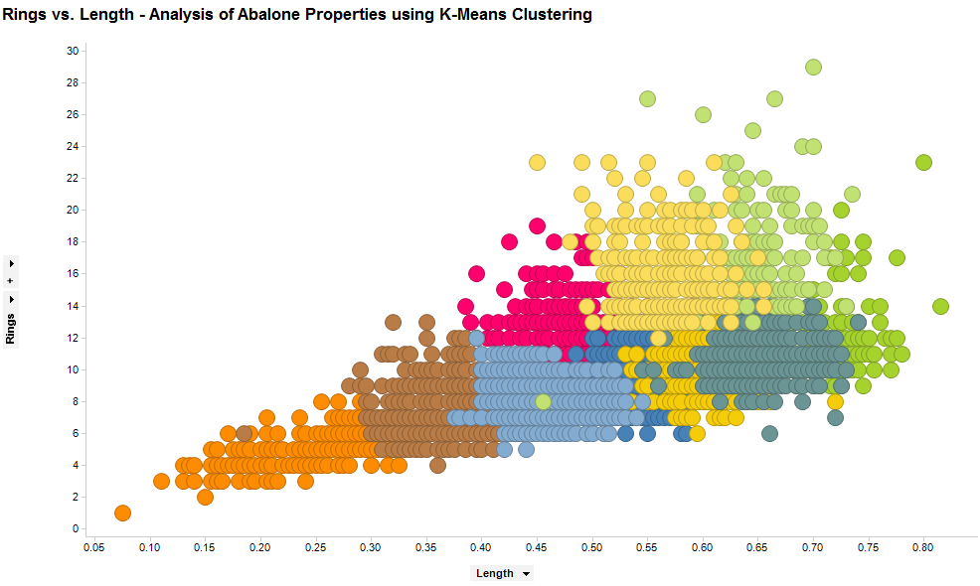
K-means Clustering Algorithm
Team members –
Neharika Mandhan
Rachita Bansal
Biplab Ghosh
Loukik Kulkarni

Slide 2
Agenda
Clustering
K-means Clustering
Steps to perform K-means Clustering
Implementation on Real Data Set in XL-Miner
Visualization of the data Set using Spotfire and R
Pros and Cons
Applications

Slide 3
What is Clustering?
Clustering refers to classification of objects into different groups, or more precisely, the partitioning of a dataset into subsets(clusters), so that the data in each subset(ideally) share some common trait – often according to some defined distance measure.

Slide 4
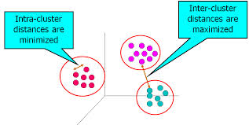
Desirable properties of a Clustering Algorithm
Higher intra-class similarity and
lower inter-class similarity
Ability to deal with different data
types
Minimal requirements for domain knowledge to determine input parameters
Able to deal with noise outlier
Insensitive to the order of input records
Incorporation of user specific constraints
Interpretability and usability
Scalability

Slide 5
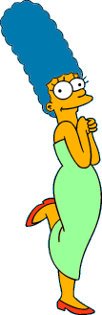






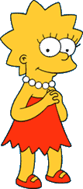



Types Of Clustering
Partitioning Algorithms
They determine the clusters all at once. They include –
K means Clustering
Fuzzy c-means Clustering
QT Clustering
Hierarchical Algorithms
These find successive clusters using previously established clusters. They Include –
Agglomerative Algorithm(Bottom Up)
Divisive Algorithms(Top-Down)

Slide 6
K-Means Clustering
K-Means algorithm is an algorithm to cluster n objects based on attributes into k partitions, where k<n
K is a positive integer
It assumes that the objects attributes form a vector space
The grouping of clusters is done by minimizing the square of the distance between data and the corresponding cluster centroids

Slide 7
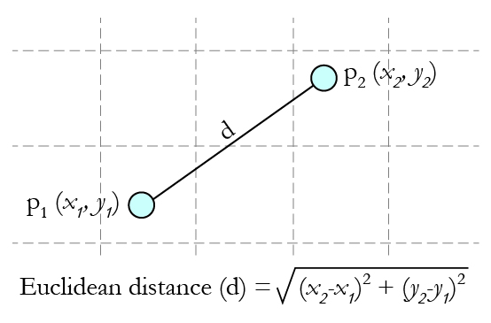
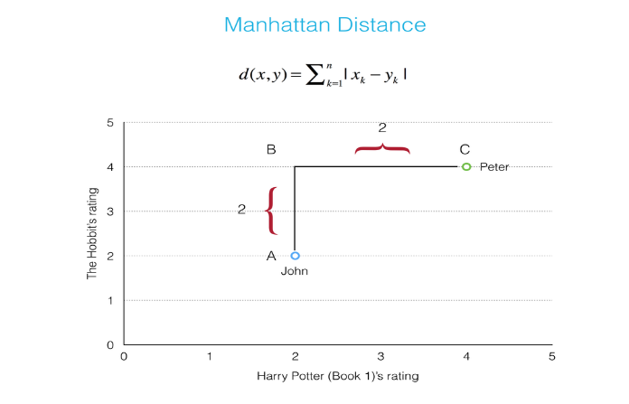
Common Distance Measures
Distance measure determines how the similarity of two elements is calculated and will influence the shape of the cluster
These include –
Euclidean Distance – Also called 2
norm distance
Manhattan Distance – Also called
taxicab norm or norm1 is given by
Mahalanobis Distance
Inner Product Space
Hamming Distance

Slide 8
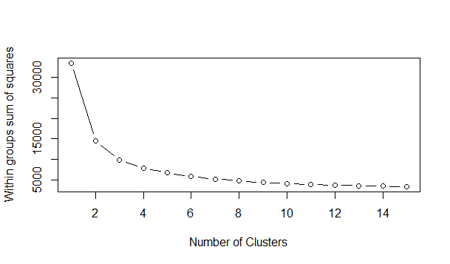
Determining the number of clusters
Elbow method is an empirical way to find the best number of clusters to be chosen to give a better modeling of data.

Slide 9
Demonstration of K-means Clustering Using an Example

Slide 10
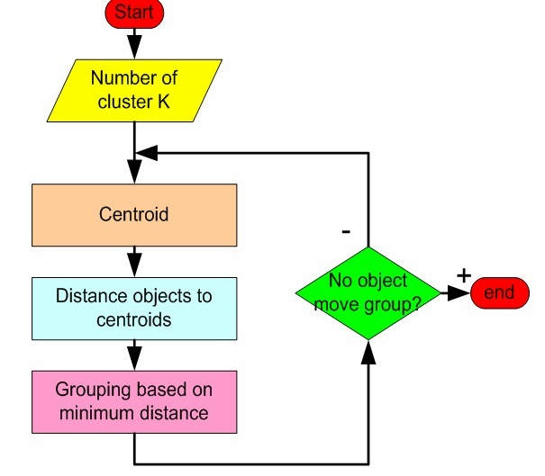
Flow of K-means Algorithm

Slide 11
We have 4 medicines as our training data points object and each medicine has 2 attributes. Each attribute represents coordinate of the object. We have to determine which medicines belong to cluster 1 and which medicines belong to the other cluster.
Object | Attribute1 (X): weight index | Attribute 2 (Y): pH
Medicine A | 1 | 1
Medicine B | 2 | 1
Medicine C | 4 | 3
Medicine D | 5 | 4

Slide 12
Step 1
Begin with decision value of k = number of clusters

Slide 13
Step 2
Put any initial partition that classifies the data into k clusters. You may assign the samples randomly, or systematically as –
1.Choose centroids equal to the number of clusters
2. Assign each of the data sample to the cluster with the nearest centroid. After each assignment, re-compute the centroid of the gaining cluster.

Slide 14
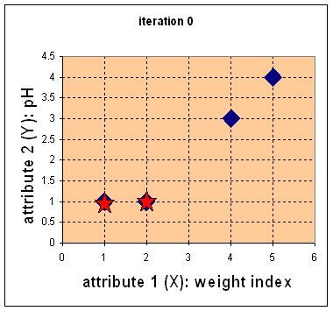
Suppose we use medicine A and medicine B as the first centroids.
Let c₁ and c₂ denote the coordinates of the centroids, then c₁=(1,1) and c₂=(2,1)

Slide 15
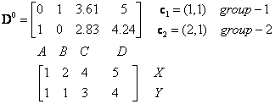

we calculate the distance between cluster centroid to each object. Let us use Euclidean distance, then we have distance matrix at iteration 0 is –
Each column in the distance matrix symbolizes the object.
The first row of the distance matrix gives the distance of each object to the first centroid and second row is the distance of each object to the second centroid.

Slide 16
Step 3
Take each Sample in the sequence and compute its distance from the centroid of each cluster. If sample is not currently in the cluster with closest centroid, switch this sample to that cluster and update the centroid of the cluster gaining the new sample and that of the cluster losing the sample.

Slide 17
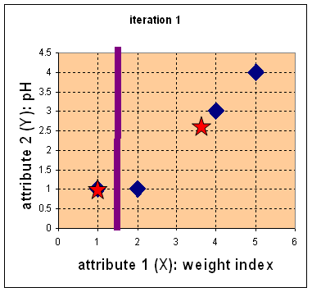
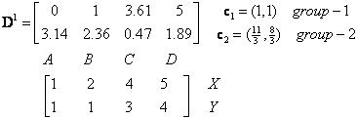
Iteration-1, Objects-Centroids distances :
The next step is to compute the distance of all objects to the new centroids.
Similar to step 2, we have distance matrix at iteration 1 is
Medicine | Cluster
A | 1
B | 1
C | 2
D | 2

Slide 18
Step 4
Repeat step 3 until full convergence is achieved, that is until a pass through the training sample causes no new assignments

Slide 19
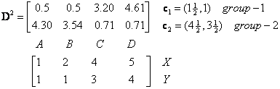
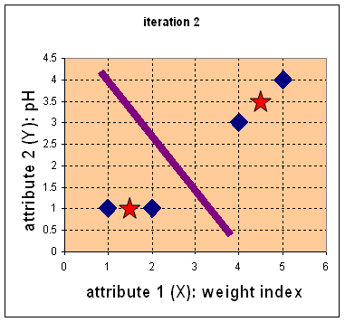
Iteration-2, Objects-Centroids distances : Repeat step 2 again, we have new distance matrix at iteration 2 as
we assign each object into clusters
based on the minimum distance.
Medicine | Cluster
A | 1
B | 1
C | 2
D | 2

Slide 20
Successive iteration reveals that the objects don’t move the groups anymore.
Thus, the computation of the k-means clustering has reached its stability and no more iterations are needed – Convergence

Slide 21
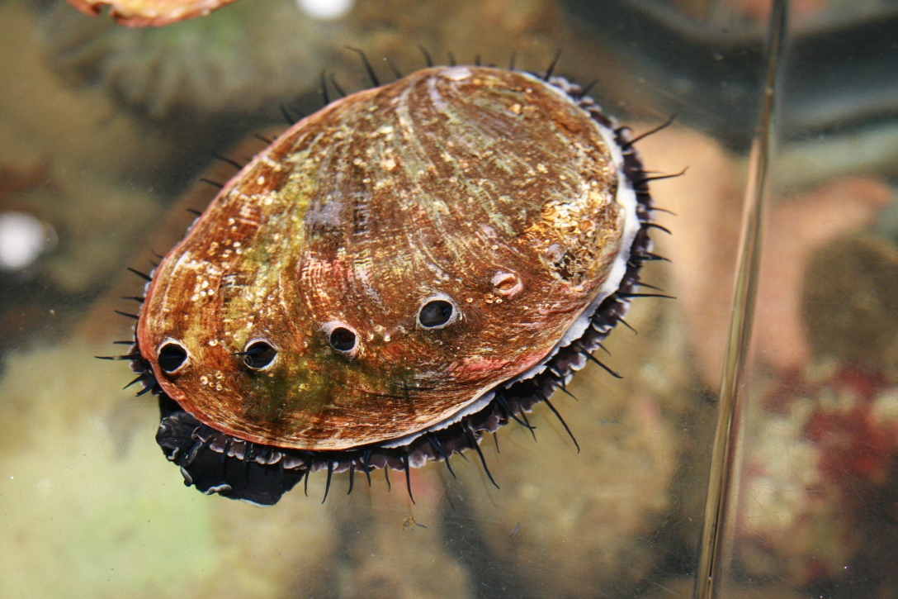
Example Data Set
Abalone Data Set
Abalone is a common
name for a group of
any small to very large
edible sea snails
We are trying to determine the properties of a cluster group of abalone based on its various attributes in the data set.

Slide 22
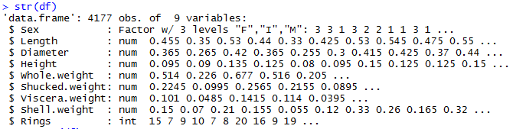
Attributes of the Data Set
Sex Height
Whole Weight Shucked Weight
Viscera Weight Shell Weight
Rings Length
Diameter

Slide 23
Demonstration of K-means Algorithm with the help of XL-Miner

Slide 24
Finding the number of Clusters using Elbow Method in R

Slide 25
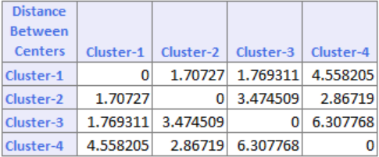
How to read the output?
Cluster Centers –
This table gives the distance between the cluster centers. As it can be seen cluster 1 is very close to cluster 2 (smallest distance 1.707) and cluster 3 is very different from cluster 4(largest distance 6.30)

Slide 26
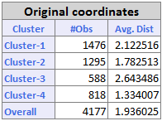
Continued…
Data Summary –
This table shows the number of cluster members in each clusters in one column and the average distance from cluster members to the center of each cluster in another column.

Slide 27
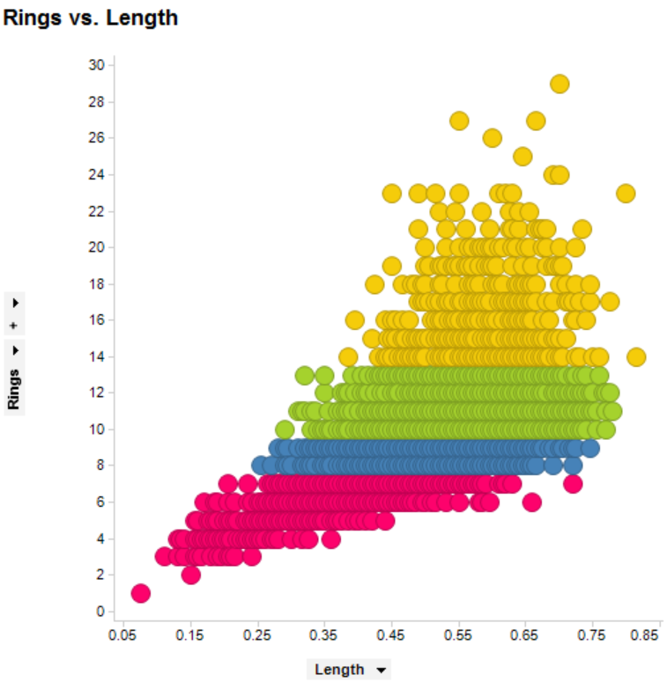
Visualizing K-means clustering

Slide 28
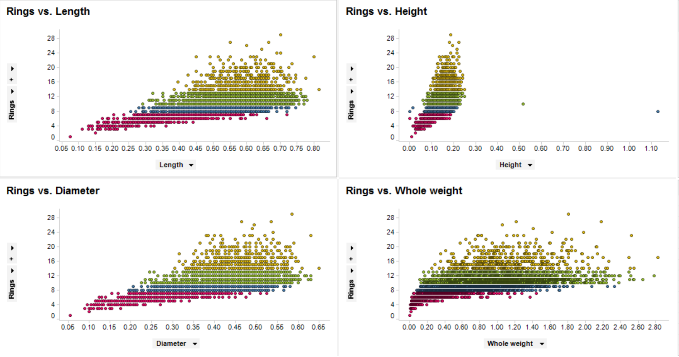

Slide 29
K-means Algorithm - Demo with R

Slide 30
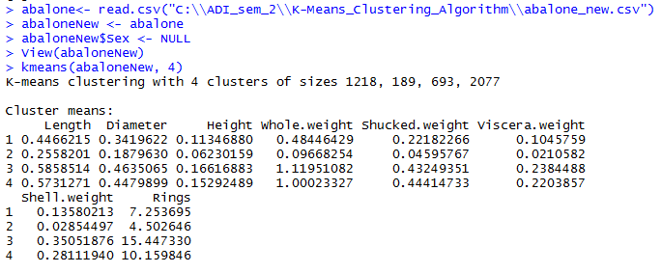
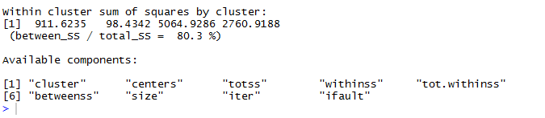

Slide 31
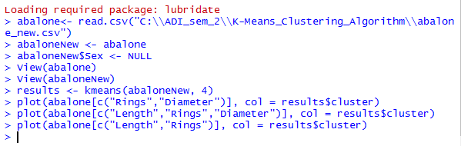
Visualizing Data using R

Slide 32
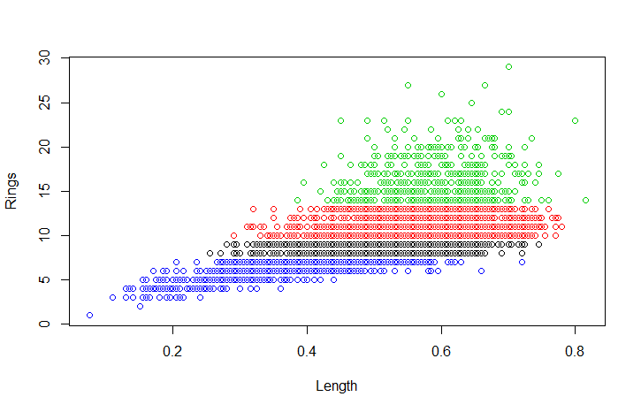

Slide 33
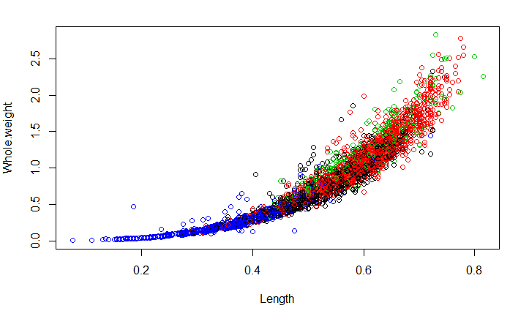

Slide 34
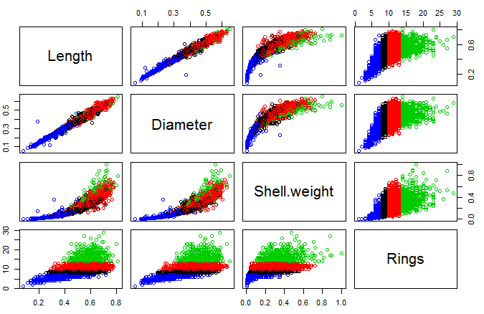

Slide 35
Comments on K-means Clustering
Strength
Relatively efficient: O(tkn), where n is # objects, k is # clusters, and t is # iterations. Normally, k, t << n.
Often terminates at a local optimum. The global optimum may be found using techniques such as: deterministic annealing and genetic algorithms
Weakness
Applicable only when mean is defined, then what about categorical data?
Need to specify k, the number of clusters, in advance
Unable to handle noisy data and outliers

Slide 36
Applications
Marketing – we may be interested in finding clusters of customers with similar buying behavior
Biometrics – authenticating with fingerprinting technology.
Diagnostic Systems – we may be interested in diagnosis of a disease based on symptoms or buy studying the genomic behavior
Optical Character Recognition – classification through the pattern matching

Slide 37
Thank you

Slide 38
Queries?

